Slide 1
494-PRE-02: Mission Data Card
Trainee Preparation
Thumper
31 OCT 2020
31 MAY 2021

Slide 2
Lesson Overview
MDC example and walk through
Creation of MDC
Where to find data
494(P)-PRE-02

Slide 3
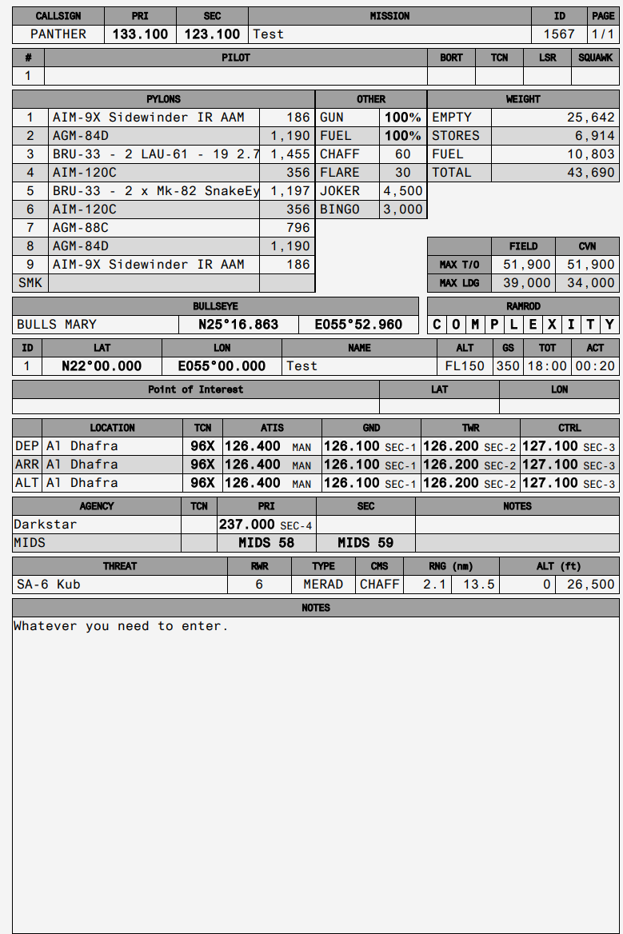
Mission Data Card example
494(P)-PRE-02

Slide 4
MDC Example walkthrough
Flight info. Name, pilots, Bort numbers (if applicable), TCN, PRF Code and M/3.
Loadout per aircraft including weights for trim calculations.
Bullseye name and location + RAMROD. Mission specific, check SPINS during planning phase.
Waypoints including names and coordinates, speeds, TOTs etc.
DEP, ARR and ALT information.
COMMS section, including MIDS for the F/A-18.
THREAT section
Notes.
494(P)-PRE-02

Slide 5
Mission Data Card Creation
Open your browser and go to http://dcs-mdc.com/
(Credits to MartinCo for making the tool!)
The generator utilizes a database containing information that is theater-specific, i.e. Persian Gulf, Syria etc.
494(P)-PRE-02

Slide 6
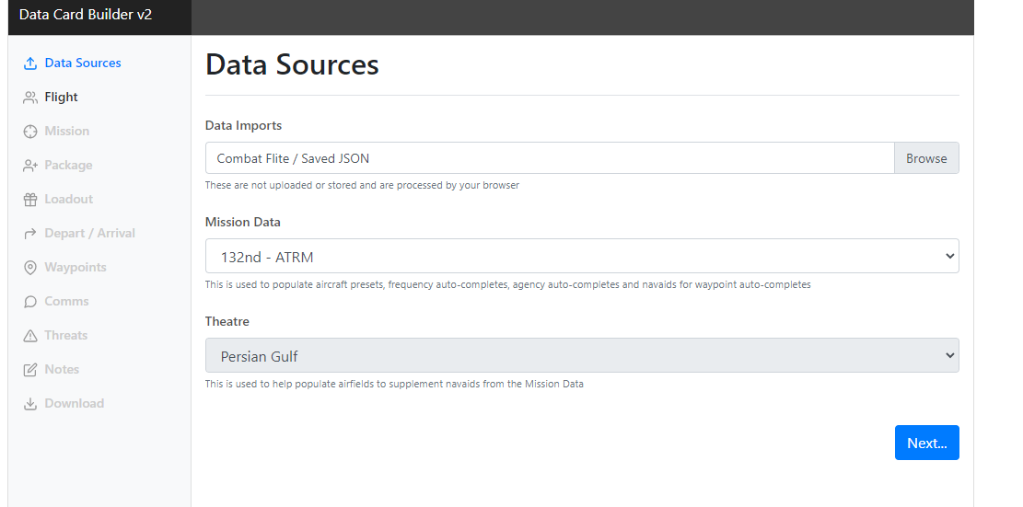
Mission Data Card Creation
Data / planning already done in Combat Flite can be imported directly into the MDC Generator, which will include loadout, frequencies, names, waypoints and so forth.
Main page / Data Sources
494(P)-PRE-02

Slide 7
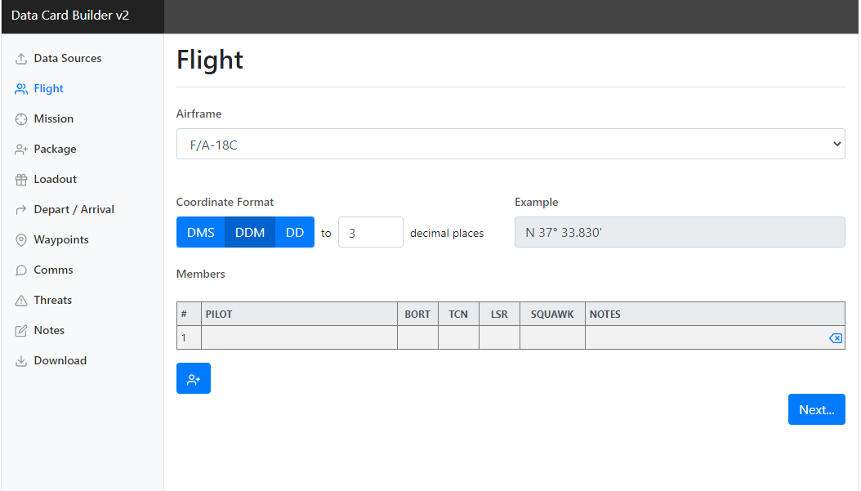
Mission Data Card Creation
Flight Page
In this section you select the airframe you’re flying. In this case the F/A-18C, which comes with a specific set of coordinate formats.
THE STANDARD FORMAT IN THE HORNET IS DDM AS SHOWN IN THE PICTURE.
Furthermore, this is where you enter the names of each pilot in your flight, including their Bort Number, Tacan, PRF/Laser Code, Squawk/Mode 3.
494(P)-PRE-02

Slide 8
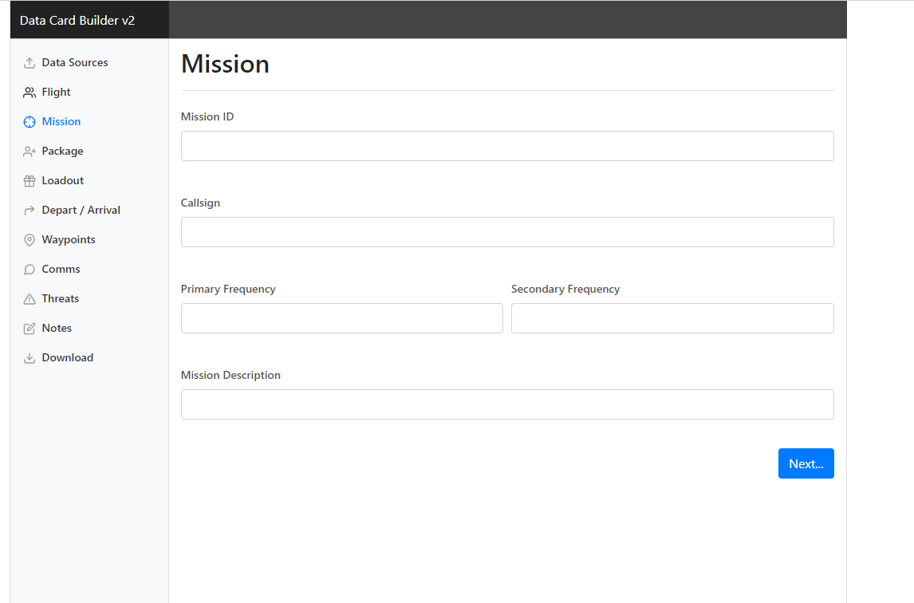
Mission Data Card Creation
Mission Page
In this section you can enter Mission ID, Callsign, frequencies and mission description / tasking information. If you imported data from CombatFlite, you will not need to re-enter the data, provided that you entered it in CombatFlite.
494(P)-PRE-02

Slide 9
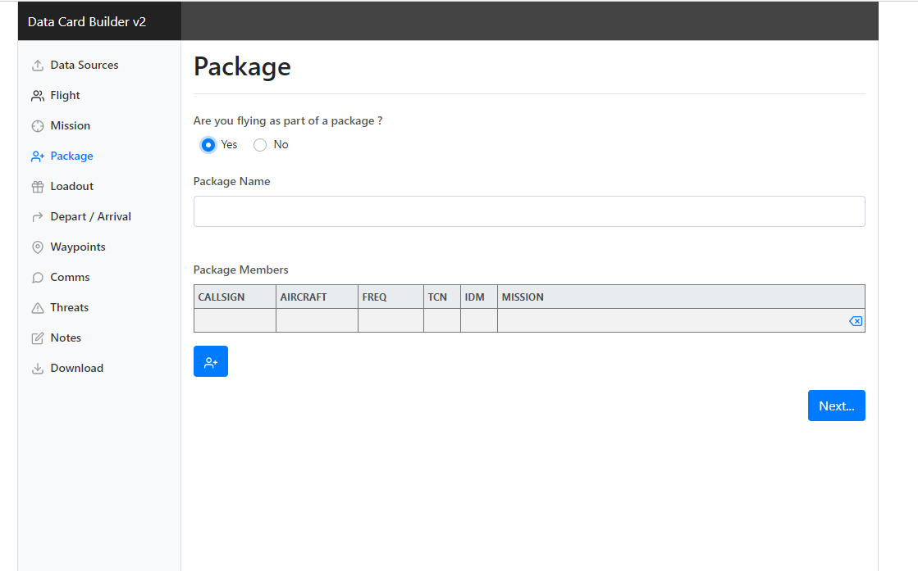
Mission Data Card Creation
Package page
If flying as part of a package, select ”Yes” and the page will expand with further fields, including Package Name and fields for entering information on your package’s composition.
494(P)-PRE-02

Slide 10
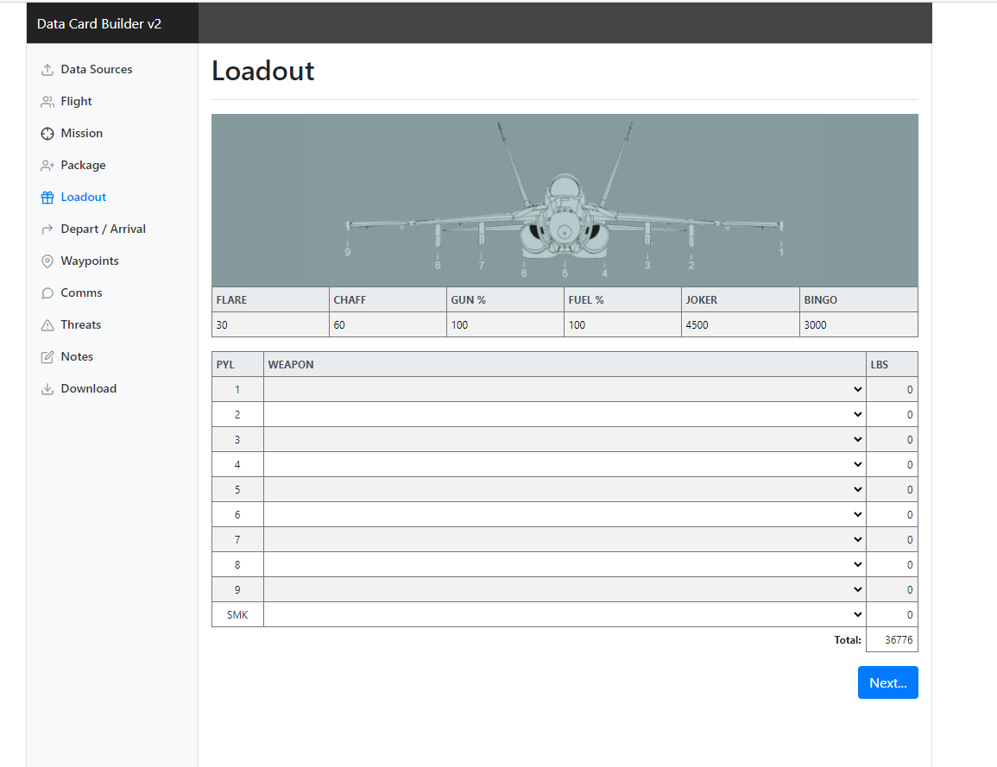
Mission Data Card Creation
Loadout Page
The Loadout page shows the various stations and is a replication of what is seen in the DCS mission editor for loadouts. You can only equip the stations depicted with ordnance that the station selected is capable to carry. Furthermore it shows weight of each selection as well as a total weight. The fields are drop-down or entry-logical selection.
494(P)-PRE-02

Slide 11
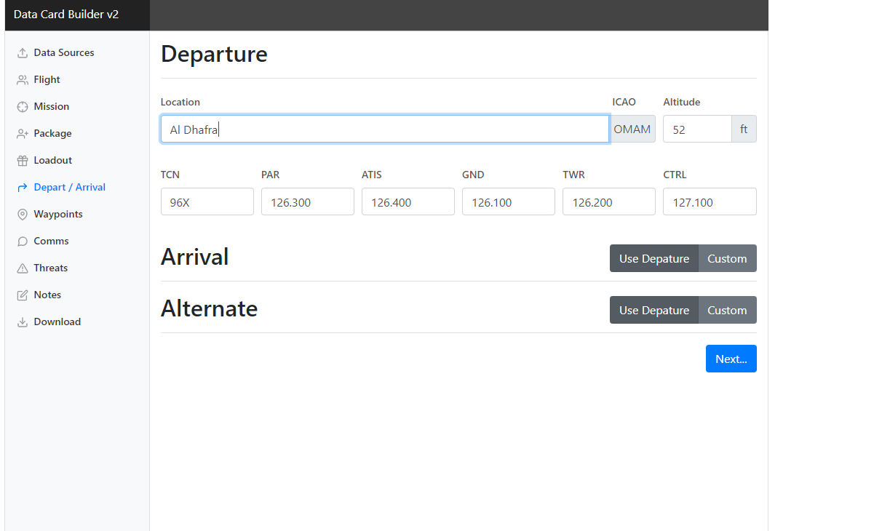
Mission Data Card Creation
DEP / ARR page
The Departure / Arrival page allows you to select departing airfield and – if applicable – arrival airfield. This draws information from the databse regarding frequencies and navigational aids and their frequencies.
494(P)-PRE-02

Slide 12
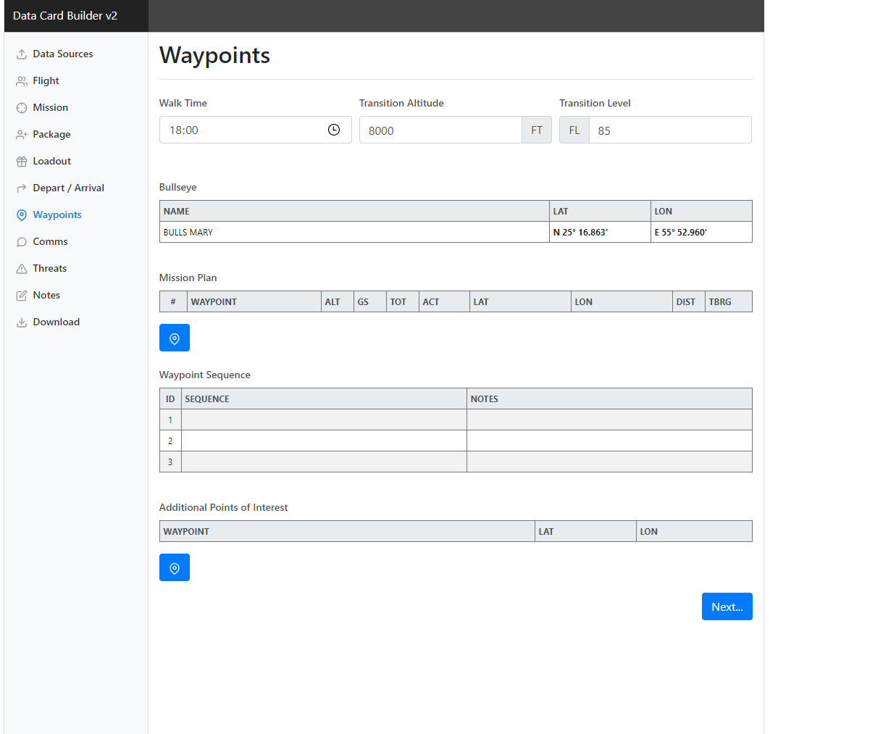
Mission Data Card Creation
Waypoints page
The waypoints page includes all navigational information as well as the option to enter points of interest that you wish to have information readily available for, but not neccessarily entered into your aircraft computer.
494(P)-PRE-02

Slide 13
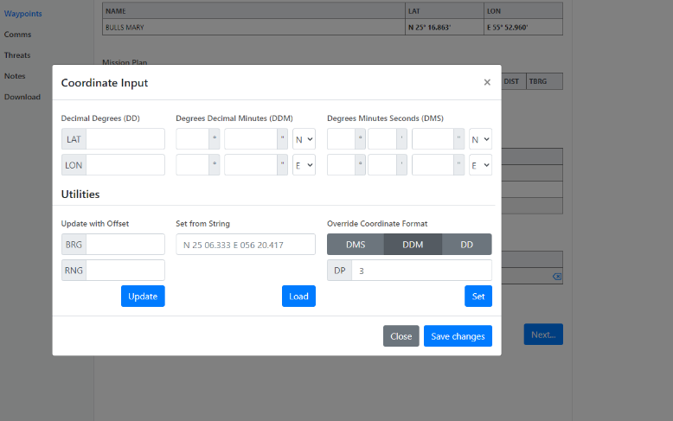
Mission Data Card Creation
Waypoints page
When you click one of the data fields when having created a new waypoint field, you will see the prompt depicted in the picture. You can insert coordinates manually, or you can copy/paste from CombatFlite and press LOAD, which will then enter all data into the field.
494(P)-PRE-02

Slide 14
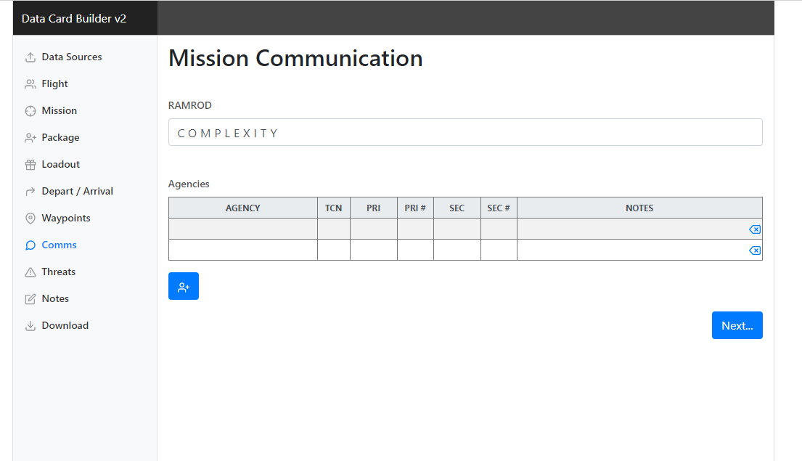
Mission Data Card Creation
COMMS page
The comms page allows you to enter information on all relevant agencies that you deem probable to be talking to. It is recommended to cover as many stations as possible that you will realistically need, as it makes for a great referencing tool during flight.
494(P)-PRE-02

Slide 15
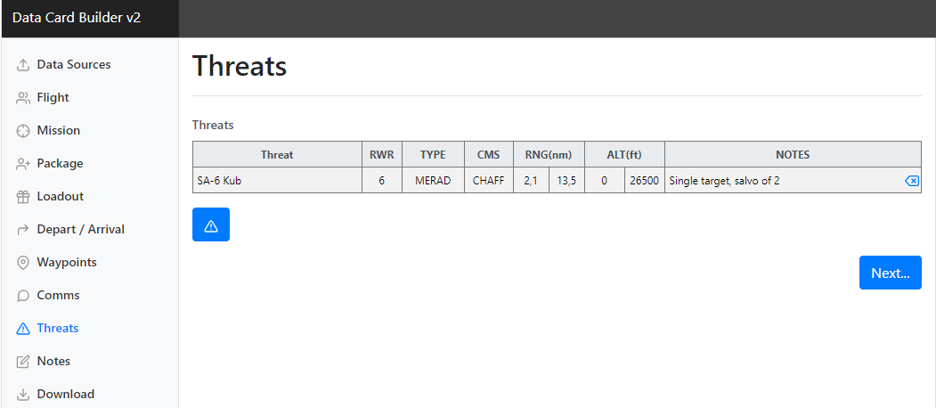
Mission Data Card Creation
COMMS page
The threat page allows you to enter information on expected threats during the mission – both groundbased and airborne threats. It also depicts the RWR indication, type of threat, which countermeasures to utilize as well as ranges and altitudes of importance. This is a entry-logical field that allows you to select from the Database, and if the threat is not available in the database, you can enter your own data.
494(P)-PRE-02

Slide 16
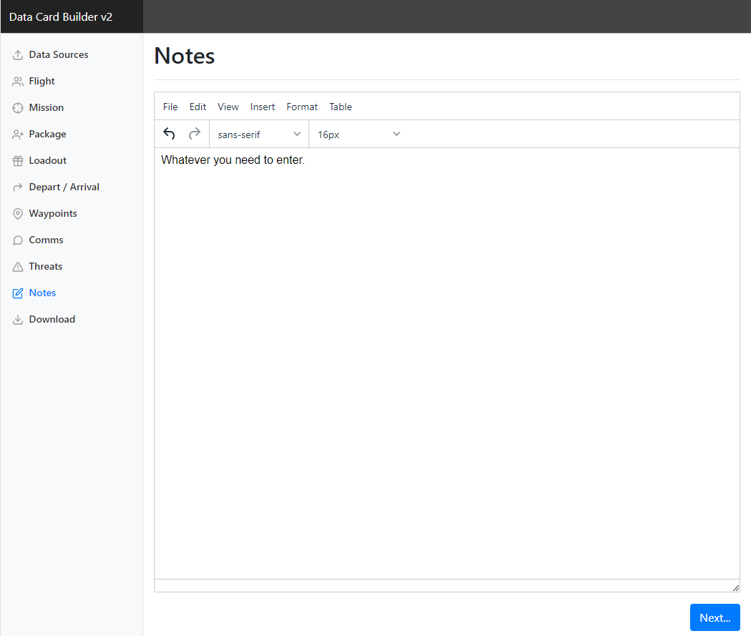
Mission Data Card Creation
Notes page
The notes page is self explanatory. If running with many variables or the need to have a gameplan in writing – i.e. A/A gameplan or scenario-specific information – it is useful to enter here. It will auto-adjust the size based on the information entered. Also allows for insertion of pictures.
494(P)-PRE-02

Slide 17
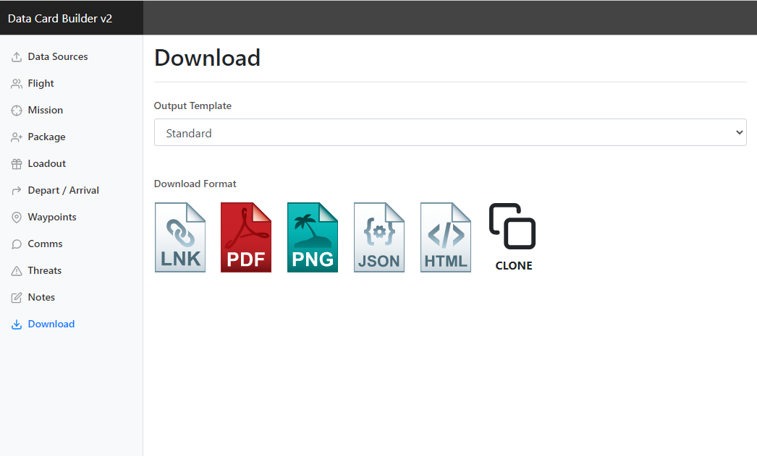
Mission Data Card Creation
Download page
The download page allows you to select output – standard or standard DARK (dark background). There are several options in terms of output, and while PNG and PDF are commonly used, it can also be recommendable to utilize the link – this allows flight members to continue work or contribute to a common Mission Data Card.
494(P)-PRE-02

Slide 18
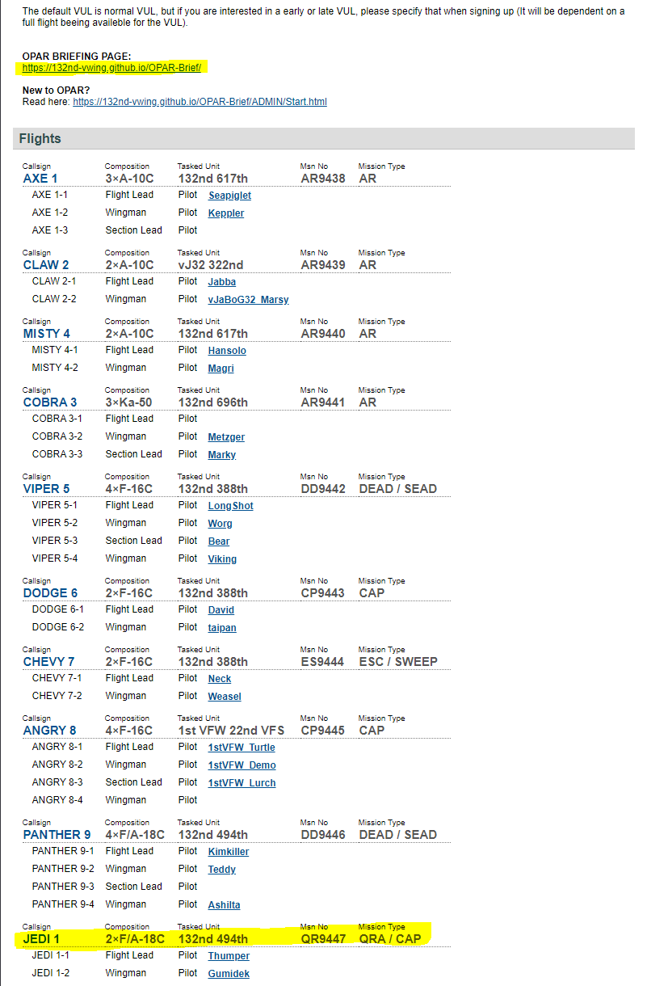
Finding data
When sourcing data for your MDC creation and flight planning, the event page is the place to start.
Start off by reading through the Briefing Page. This is mission specific, and contains generic information for the ATRM if flying a training sortie, and mission specific information for events, i.e. OPAR.
For flight-specific information, click on the Callsign of the flight which you have been assigned to.
494(P)-PRE-02

Slide 19
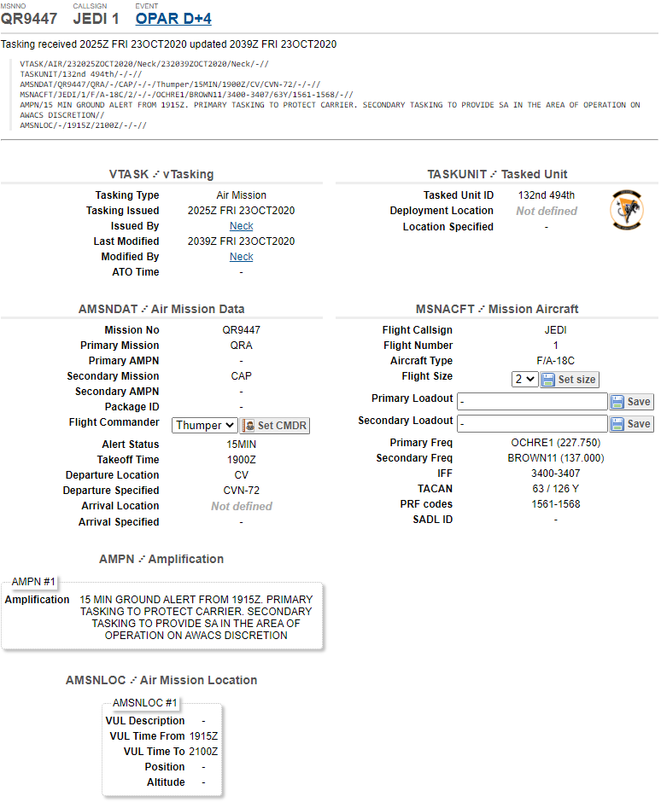
Finding data
When you have clicked the Call Sign of your assigned flight, you will enter the CommsChatter of said flight.
In here, you can find most of the information relevant to your exact flight.
This could be PRI/SEC frequencies, IFF codes, Tacan codes, PRF/Laser codes and so forth.
Furthermore, you can find the raw-data ATO tasking at the top.
494(P)-PRE-02

Slide 20
Finding data
The briefing page of each mission / event contains the information you also need to accomplish your mission.
This includes but is not limited to: Bullseye, RAMROD, ID-matrix, Codewords, Specific frequencies, CombatFlite file to be used for planning and so forth.
494(P)-PRE-02

